Slide 1

CS9101: DoD Career Navigation Badge
Text To Speech Using Azure

Slide 2
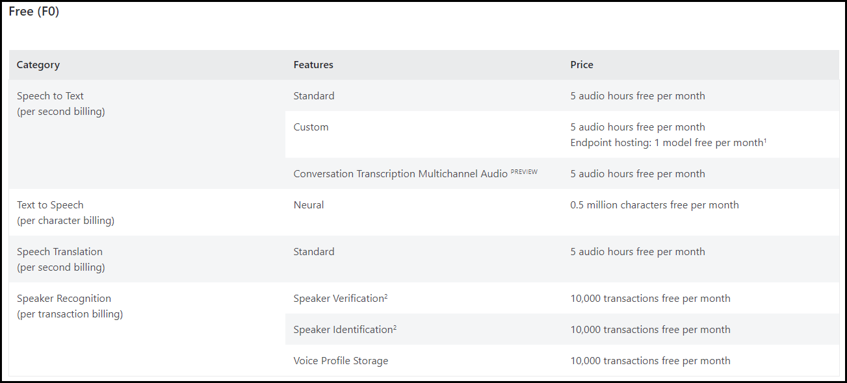
Pricing – Free Tier

Slide 3


Standard Web/Container
Speech to Text
Standard²
$1 per audio hour
Custom
$1.40 per audio hour Endpoint hosting: $0.0538 per model per hour
Enhanced add-on features:
$0.30 per audio hour per feature
Conversation Transcription Multichannel Audio ^{PREVIEW}
$2.10 per audio hour¹
Text to Speech
Real-time synthesis: $16 per 1M characters Long audio creation: $100 per 1M characters
Custom Neural²
Training: $52 per compute hour
Speech Translation
Standard
$2.50 per audio hour
Speaker Recognition
N/A per 1,000 transactions
Speaker Identification
N/A per 1,000 transactions
Voice Profile Storage
N/A per 1,000 voice profiles (10,000 free voice profiles per month)
Speaker Verification
up to $4,992 per training
Real-time synthesis: $24 per 1M characters
Endpoint hosting: $4.04 per model per hour Long audio creation: $100 per 1M characters
Neural
Language identification
Batch diarization for 3+ speakers
Base model
100 concurrent requests
Custom model
20 concurrent requests
Text-to-Speech
PerCharacterBilling
Speech Translation
PerSecondBilling
Speaker Recognition
PerTransactionBilling)
Notes:
Speech to Text
Standard
$1 per audio hour
Custom
$1.40 per audio hour Endpoint hosting: $0.0538 per model per hour
Enhanced add-on features:
Language identification
Batch diarization for 3+ speakers
$0.30 per audio hour per feature
Conversation Transcription Multichannel Audio ^{PREVIEW}
$2.10 per audio hour¹
Text to Speech
Neural
Real-time synthesis:
$16 per 1M characters Long audio creation:
$100 per 1M characters
Custom Neural²
Training: $52 per compute hour
up to $4,992 per training
Real-time synthesis: $24 per 1M characters
Endpoint hosting: $4.04 per model per hour Long audio creation: $100 per 1M characters
Speech Translation
Standard
$2.50 per audio hour
Speaker Recognition
Speaker Verification
N/A per 1,000 transactions
Speaker Identification
N/A per 1,000 transactions
Voice Profile Storage
N/A per 1,000 voice profiles (10,000 free voice profiles per month)

Slide 4
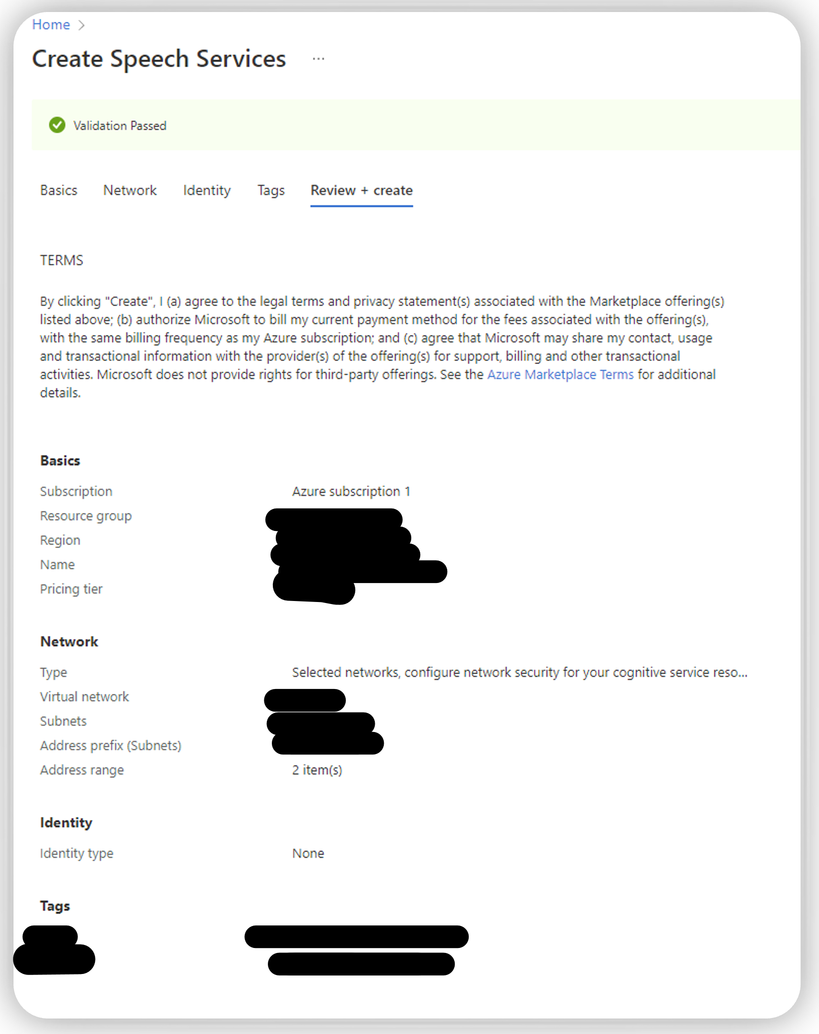
Azure
Create Resources
Cognitive resource ID
Account Restrictions
Free Tier
Notes:
Created the text-to-speech application using azure.

Slide 5
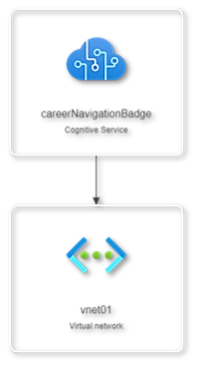
Network Resources Visualization
Part of Azure
Resource Utilization
Easier to manage resource groups when you can see how they’re related to each other

Slide 6

Speech Resources
Programming language | Platform support
C# - .net | Windows, Linux, macOS, Mono, Xamarin.iOS, Xamarin.Mac, Xamarin.Android, UWP, Unity
C++ | Windows, Linux, macOS
Go | Linux
Java | Android, Windows, Linux, macOS
JavaScript | Browser, Node.js
Objective-C | iOS, macOS
Python | Windows, Linux, macOS
Swift – objective-C | iOS, macOS
Speech SDK
Notes:
About the Speech SDK - Speech service - Azure Cognitive Services | Microsoft Learn

Slide 7
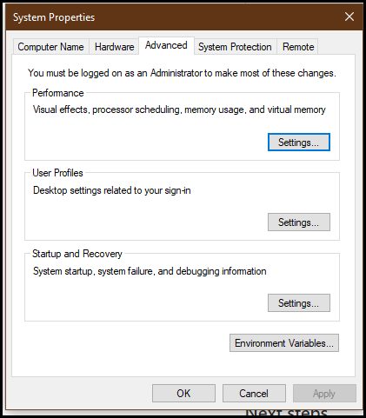
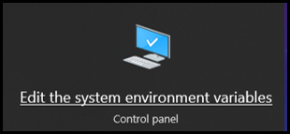
Add Environment

Slide 8
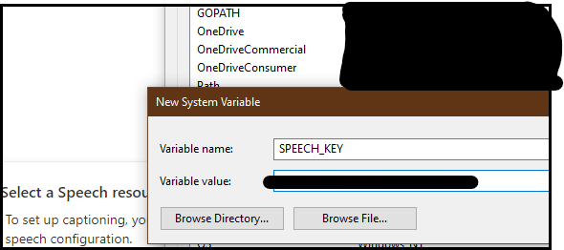
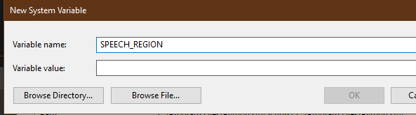
Set Key - Variables
Windows
setx SPEECH_KEY your-key
Linux
export SPEECH_KEY=your-key
NOTE: After you add the environment variable, run source ~/.bashrc from your console window to make the changes effective.
MAC
About same as Linux
Notes:
Text-to-speech quickstart - Speech service - Azure Cognitive Services | Microsoft Learn
This is all assuming that youre using python for your configuration as they have an sdk kit for C#, C++, Go, Java, JavaScript, Objective-C, Python, Swift, CLI, & REST
To set the environment variable for your Speech resource region, follow the same steps. Set SPEECH_REGION to the region of your resource. For example, <code>westus</code>

Slide 9
SSML Speech Synthesis Markup Language
Scenarios
You can use SSML to:
Define the input text structure that determines the structure, content, and other characteristics of the text-to-speech output. For example, you can use SSML to define a paragraph, a sentence, a break or a pause, or silence. You can wrap text with event tags such as bookmark or viseme that can be processed later by your application.
Choose the voice, language, name, style, and role. You can use multiple voices in a single SSML document. Adjust the emphasis, speaking rate, pitch, and volume. You can also use SSML to insert pre-recorded audio, such as a sound effect or a musical note.
Control pronunciation of the output audio. For example, you can use SSML with phonemes and a custom lexicon to improve pronunciation. You can also use SSML to define how a word or mathematical expression is pronounced.
Notes:
Speech Synthesis Markup Language (SSML) overview - Speech service - Azure Cognitive Services | Microsoft Learn

Slide 10

Use SSML
You're billed for each character that's converted to speech, including punctuation. Although the SSML document itself is not billable, optional elements that are used to adjust how the text is converted to speech, like phonemes and pitch, are counted as billable characters. For more information, see text-to-speech pricing notes.
Audio Content Creation tool: Author plain text and SSML in Speech Studio: You can listen to the output audio and adjust the SSML to improve speech synthesis. For more information, see Speech synthesis with the Audio Content Creation tool.
Batch synthesis API: Provide SSML via the inputs property.
Speech CLI: Provide SSML via the spx synthesize --ssml SSML command line argument.
Speech SDK: Provide SSML via the "speak" SSML method.
Notes:
Speech Synthesis Markup Language (SSML) overview - Speech service - Azure Cognitive Services | Microsoft Learn

Slide 11
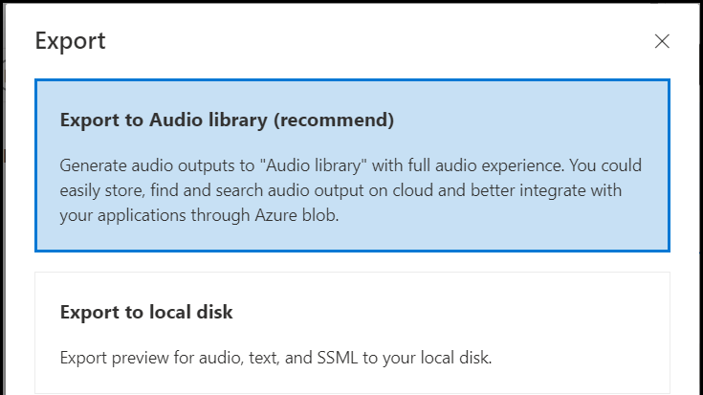

Speech PAckage
azure.cognitiveservices.speech package | Microsoft Learn

Slide 12
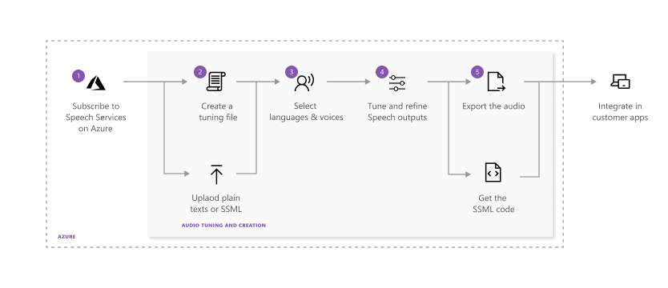
Using the Speech Studio Tool
Notes:
Each step in the preceding diagram is described here:
Choose the Speech resource you want to work with.
Create an audio tuning file by using plain text or SSML scripts. Enter or upload your content into Audio Content Creation.
Choose the voice and the language for your script content. Audio Content Creation includes all of the prebuilt text-to-speech voices. You can use prebuilt neural voices or a custom neural voice.
Note
Gated access is available for Custom Neural Voice, which allows you to create high-definition voices that are similar to natural-sounding speech. For more information, see Gating process.
Select the content you want to preview, and then select Play (triangle icon) to preview the default synthesis output.
If you make any changes to the text, select the Stop icon, and then select Play again to regenerate the audio with changed scripts.
Improve the output by adjusting pronunciation, break, pitch, rate, intonation, voice style, and more. For a complete list of options, see Speech Synthesis Markup Language.
For more information about fine-tuning speech output, view the How to convert Text to Speech using Microsoft Azure AI voices video.
Save and export your tuned audio.
When you save the tuning track in the system, you can continue to work and iterate on the output. When you're satisfied with the output, you can create an audio creation task with the export feature. You can observe the status of the export task and download the output for use with your apps and products.

Slide 13
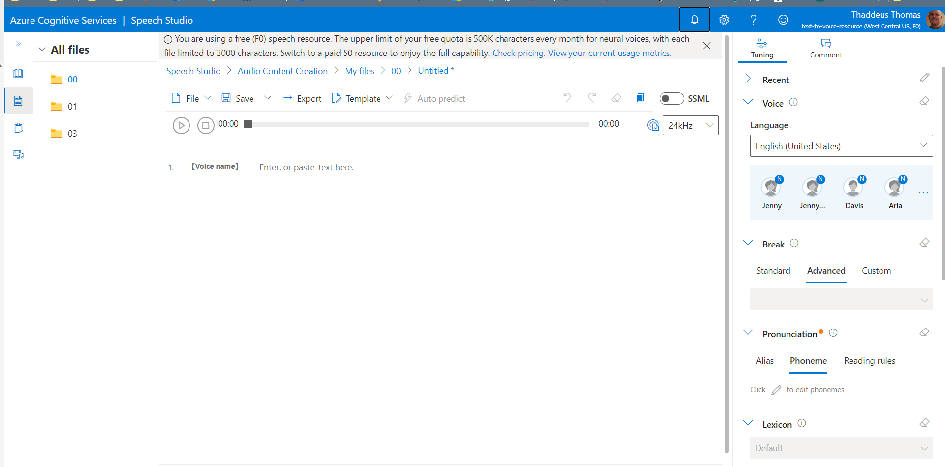

Speech Studio
500k a month
3000 char a file
Notes:
500k a month
3000 char per file
Not all of the SSML is functional
Speech synthesis markup language

Slide 14
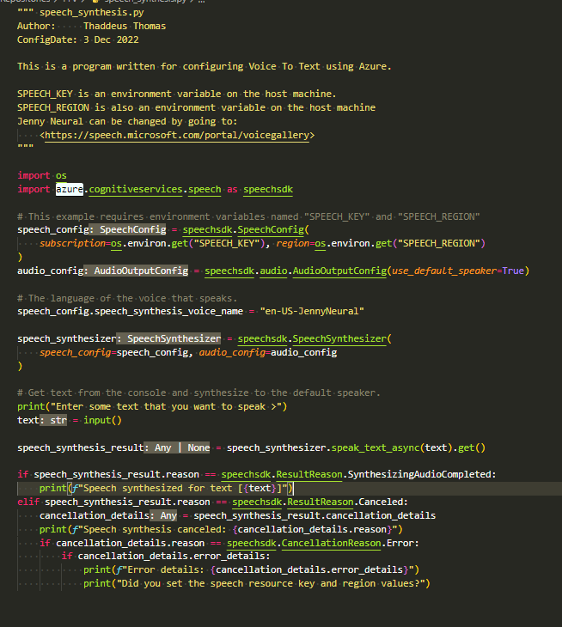
Python
Simplest SDK
No Errors

Slide 15

Results

Slide 16
References
VTT
Name | Link | Type
 | - | Annotation
Quickstart: Create a Cognitive Services resource using the Azure portal | Learn.microsoft | Citations
Embedded Speech (preview) | Learn.microsoft | Citations
Quickstart: Convert text to speech | Learn.microsoft | Citations
Azure Samples/cognitive services speech sdk: Sample code for the Microsoft Cognitive Services Speech SDK | Github | Website
AzureSpeechReactSample OneDrive | Cityuseattle-my.sharepoint | Website
My Dashboard Microsoft Azure | Portal.azure | Website
Deploy and run a containerized web app with Azure App Service Training Microsoft Learn | Learn.microsoft | Website
azure sdk for python/sdk/textanalytics/azure ai textanalytics/samples at main · Azure/azure sdk for python | Github | Website
azure cognitiveservices search imagesearch package Microsoft Learn | Learn.microsoft | Website
Batch synthesis API (Preview) for text to speech | Learn.microsoft | Citations
Speech synthesis with the Audio Content Creation tool | Learn.microsoft | Citations
Quickstart: Create a Cognitive Services resource using the Azure portal | Learn.microsoft | Citations
Install the Speech SDK | Learn.microsoft | Citations
Azure Products by Region Microsoft Azure | Azure.microsoft | Website

Slide 17
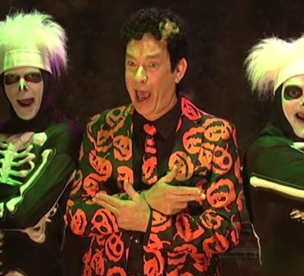
Q&A

